Slide 1
CHAPTER 13: PROMOTIONAL ESSENTIALS: DIGITAL AND SOCIAL MEDIA MARKETING
McGraw-Hill Education
Part 5: Communicate the Value Offering

Slide 2
Learning Objectives
Understand promotion and identify the elements of the promotion mix.
Explain the hierarchy of effects (AIDA) model and its usefulness to promotional strategy.
Discuss the role and key types of digital marketing in communicating value to customers.
Identify the key types of social media and their benefits to marketers in communicating value to customers.

Slide 3
Essentials Of Promotion and Integrated Marketing Communications
Promotion involves various forms of communication to inform, persuade, or remind.
Promotion Mix
Advertising
Sales promotion
Public relations
Personal selling
Digital and social media marketing
Notes:
Digital & Social Media Marketing
Advertising Paid form of relatively less personal marketing communications, often through a mass medium to one or more target markets. Example media include television, radio, magazines, newspapers, and outdoors.
Sales Promotion Provides an inducement for an end-user consumer to buy your product or for a salesperson or someone else in the channel to sell it. Designed to augment other forms of promotion; rarely used alone. Example sales promotion tools for customers are coupons, rebates, and sweepstakes. Inducements for channel members often involve special monies or prizes for pushing a particular offering.
Public Relations (PR) Systematic approach to influencing attitudes, opinions, and behaviors of customers and others. Often executed through publicity, which is an unpaid and relatively less personal form of marketing communications usually through news stories and mentions at public events.
Personal Selling One-to-one personal communication with a customer by a salesperson, either in person or through other means.

Slide 4
Promotion Mix Strategies
Promotional strategies involve decisions about which combination of elements of the promotion mix best communicate with customers and potential customers.
A promotion campaign tracks the effectiveness and efficiency of the promotional strategies for a particular product or product line over a given time period.

Slide 5
Push and Pull Strategies
In a push strategy, the focus is on the channel of distribution and in getting the offering into the channel.
In a pull strategy, the focus shifts to stimulating demand for an offering directly from the end user.

Slide 6
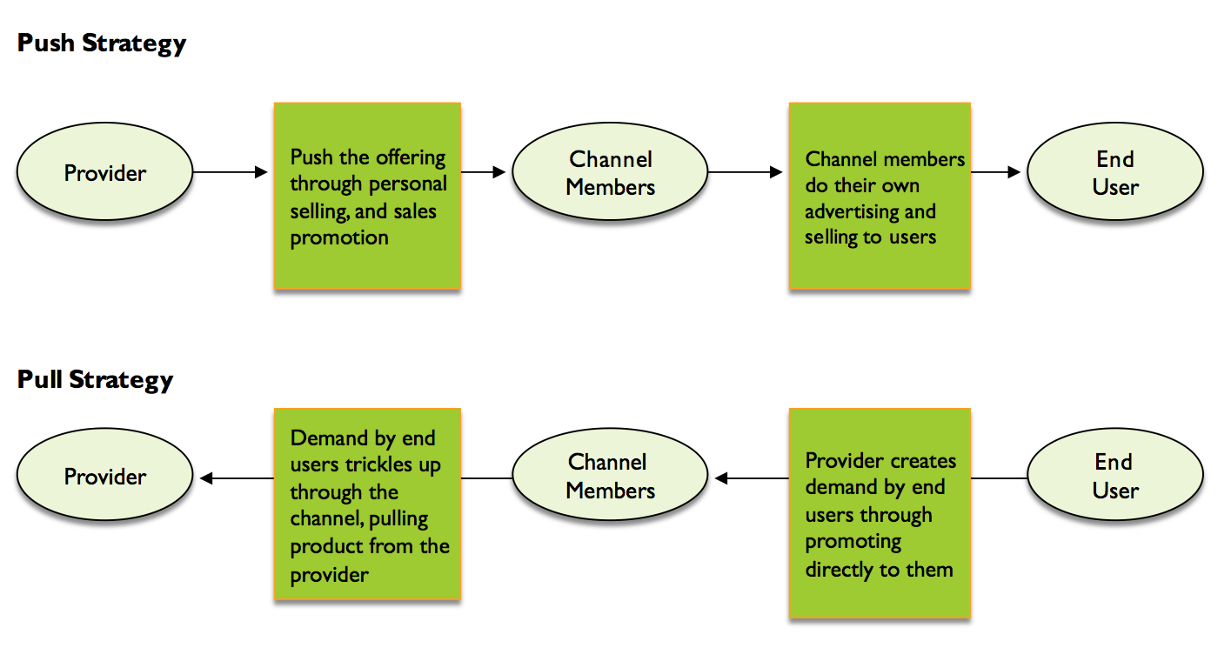
Push and Pull Promotional Strategies
EXHIBIT 13.6
Link to long alt text description

Slide 7
Illustrative Factors Influencing Strategy
EXHIBIT 13.4
Advertising/sales promotion driven | Factor | Personal selling driven
Large | Balanced number and dispersion of buyers | Small
Low | Buyers’ information needs | High
Small | Size and importance of purchase | Large
Little | Post-purchase contact required | Much
Low | Product complexity | High
Channel | Distribution | Direct
Preset | Pricing | Negotiated
Source: Reprinted from David W. Cravens and Nigel F. Piercy, Strategic Marketing, 10th ed, 2013. Copyright © 2013 The McGraw-Hill Companies Inc.
Notes:
What kinds of decisions are involved in developing and executing IMC strategy? Consider Exhibit 13.4, which compares the impact of marketing management factors in an IMC approach with those of a personal selling approach. As you can see, a gamut of critical issues from buyer information needs to purchase size to the configuration of the marketing mix elements all influence the decision about where to invest promotional budget dollars. In fact, in many marketing-planning situations the promotional budget is the lion’s share of the overall marketing budget—typically surpassing packaging, distribution, and other marketing elements by a wide margin.

Slide 8
Selected Pros and Cons of Individual Promotion Mix Elements
EXHIBIT 13.5
Promotion Mix Element | Pros | Cons
Digital and social media | Message customization without high costs of personal selling. Strong relationship building especially when customer can control the interaction. | SPAM and other unwanted correspondence when targeting is poorly executed. Reliance on CRM and database marketing requires constant updating.
Advertising | Many media choices. Efficiently reach large numbers of customers. Great creative flexibility. | Shotgun approach reaches many outside the target. Oversaturation of ads lessens impact. High production costs.
Sales promotion | Stimulates purchase directly through incentive to buy. Serves as an effective accompaniment to other promotion forms. | Can lead customers to continually wait for the next coupon, rebate, etc. Brand may be impacted by price-cutting image.
Public relations | Unpaid communication seen as more credible than paid forms. Association of offering with quality media outlet enhances brand. | Low control of how the message turns out. Highly labor intensive cost of mounting PR campaigns.
Personal selling | Strong two-way communication of ideas. Directly ease customer confusion and persuade purchase. | Very expensive cost per customer contact. Salesperson may go “off message” from brand in order to secure the sale.

Slide 9
Internal Marketing
Internal marketing is the application of marketing concepts within the organization.
Knowledgeable employees can effectively communicate the branding message. They are be firm’s best brand ambassadors.
HR departments help in training employees in the brand messages (e.g., Starbucks, Nordstrom’s, Ritz Carlton).

Slide 10
Hierarchy of Effects Model
Buyers often pass through purchase decision processes in three steps: cognitive (learn), affective (feel), and behavioral (do).
These stages are portrayed in various models to illustrate this hierarchy of effects in the context of customer response to marketing communications.
The AIDA hierarchy of effects model is well known.

Slide 11
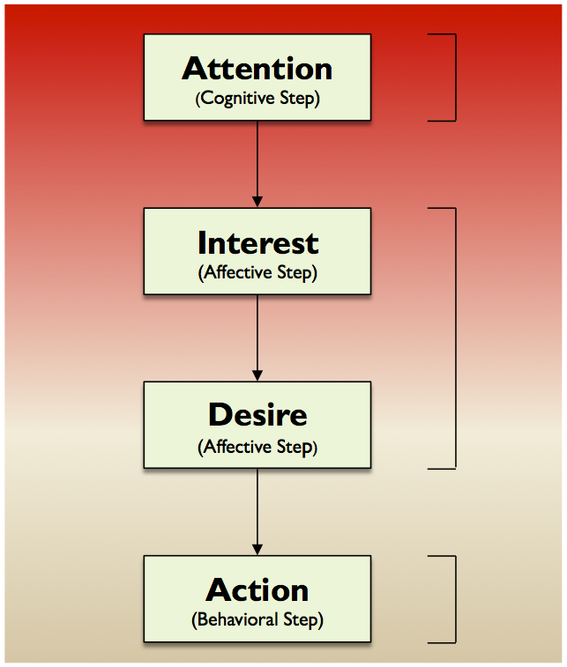
AIDA Model
EXHIBIT 13.8
Link to long alt text description
Notes:
Attention: If target customers are essentially unaware of an offering, most of the investment in communication must be in raising awareness and gaining their attention. Depending on the situation, this may involve developing the customer’s awareness for a whole new set of customer needs and wants as well as revealing that your product exists to address those needs and wants. Gaining attention and building initial awareness can be a daunting task for marketers. Tremendous expenditures may be required to establish a foothold with customers, especially when a brand is relatively unknown or a product category is in its infancy.
Interest: To translate customer attention into interest requires persuasive communication. For more technical or complicated products, this means beginning to inform customers more specifically about what a product offering can do for them—how it helps fulfill needs and wants. To stimulate interest, the promotion must begin to touch a customer’s hot buttons.
Desire: Moving from interest to desire means that a customer has to move past a need and begin to really want that specific product. Promotion feeds desire through strong persuasive communication. At this stage, salespeople and customized direct and interactive marketing enter the promotion mix. Messages are altered to influence customers to feel that they simply can’t do without the item. The innovators and early adopters show off their purchases to holdouts, and the ball is rolling.
Action: The action stage is the purchase itself. To stimulate ultimate purchase, marketers often rely on salespeople, accompanied by some form of sales promotion, to close the sale. The reason sales organizations put so much emphasis on training salespeople in closing techniques is that they are seen as the final stimulant to purchase.

Slide 12
General Suggestions for Applying Promotion Mix Elements at AIDA Stages
Promotion Mix Element | Attention Stage | Interest Stage | Desire Stage | Action Stage
Digital and Social Media Marketing | 3 | 3 | 3 | 3
Advertising | 3 | 3 | 2 | 2
Sales Promotion | 2 | 2 | 3 | 3
Public Relations | 3 | 3 | 2 | 1
Personal Selling | 1 | 1 | 3 | 3
1 = Generally least appropriate for use 3 = Generally most appropriate for use

Slide 13
The Role of Digital Marketing in Communicating Value
Digital marketing is using digital technologies like desktops, laptops, tablets, and smartphones to market value offerings. It may be the most critical component of promotional strategy.
It is essential because customers control when, where, and how they interact with marketers.
Data collection is easier and less expensive than ever and with more depth and breadth than ever and gives marketers a more holistic view of people.
Notes:
The data collection capabilities facilitated by digital technologies enable marketing managers to gain access to information on customers at a breadth and depth never before possible, and at reasonable cost. These data can be collected either through interactions a firm creates or engages in with a customer or via interactions that customers have with each other without direct firm involvement. As customers increasingly search for information, make transactions, and communicate through digital channels an increasing amount of data will become available, enabling marketers to gain a more holistic view of individuals .

Slide 14
Examples of Digital Options for Marketing Information Sharing
Infographics | Webinars | Videos
Block Posts | Lists | FAQs
Testimonials | Case Studies | Whitepapers

Slide 15
Types of Media
EXHIBIT 13.10
 | Examples | Advantages | Potential Issues
Paid Media | Display ads Search ads Native ads Social network ads | Speed Flexibility Targeting capabilities Scalability Control Measurability | Difficulty standing out Declining response rates Potential credibility issues
Owned Media | Firm’s website (mobile and desktop) Email Firm’s blog Firm’s social media accounts | Longevity Flexibility Ability to speak to the niche audiences in depth | Potential credibility issues Potentially substantial development effort required Desired results may be achieved over longer time horizons
Earned Media | Social media shares User reviews of products Mentions of an organization on third party’s website or social media | Credibility Potential cost efficiencies Transparency | Lack of control Communications and conversations may be negative Value can be difficult to measure
Notes:
Paid media refers to marketing communication channels requiring that the marketer pays someone else for customer access. In digital marketing, access to paid media can generally be purchased on a per unit basis. Common pricing models include cost-per-impression , in which the marketing manager pays a set amount each time a customer is exposed to the promotion and cost-per-click, in which the marketing manager pays a set amount each time a customer clicks on a link.
Owned media refers to marketing communication channels that the marketer’s organization has complete control over. The content created on an organization’s website is an example of owned media.
Earned media is a bit different as it refers to the case where either a customer or a commercial entity (such as a news media organization) chooses to act as a marketing communication channel for the dissemination of information associated with the marketer’s organization at no cost. An example is when a customer shares a link to a blog post about a new product’s launch on a social network because he or she is excited about the new product.

Slide 16
Digital Advertising
Digital advertising is the creation and execution of an advertisement via any form of digital media.
Benefits:
Rich data allows for a granular view of the ad’s performance.
Strategy can be quickly adjusted.
Distribute different information to different customer groups.
Ad expense is justified by targeting desired customers.
Notes:
Like other digital marketing efforts, digital advertising benefits from the richness of data that is generated by the customer’s exposure to the ad, which in turn allows for a more granular review of the ad’s performance. This measurement capability is especially clear when a digital ad drives a customer to take a specific action on a website that has a clear monetary value, such as when an ad contains a promotional offer to purchase a product at a discounted rate and clicking on it leads to a page where the offer can be redeemed and purchase made. The ad’s value in generating sales can be directly measured by how many customers were exposed to the ad and how many of those exposed customers redeemed the offer. Unlike most non-digital types of advertising, with this approach the promotional strategy can be quickly adjusted if the data indicate that the current message isn’t working well.
Because some digital communication channels such as social networking platforms and search engines are designed so that what is displayed on their pages can be custom-adjusted for a given viewer at relatively minimal costs, the marketer is afforded great flexibility in the communication.

Slide 17
Display Ads
Digital ads are clearly distinguished from the webpage’s primary content.
Banner ads are boxes embedded into a website and can include graphics, text, videos, hyperlinks.
Average click through rate is 4 out of 10,000.
Interstitials are full page ads are shown before the viewer is directed to the intended page visit.

Slide 18
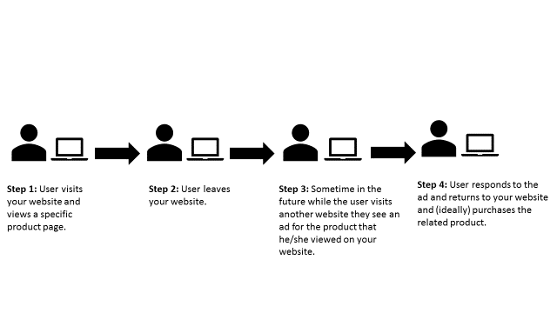
Retargeting
Retargeting displays ads for a given product on different websites after the customer as visited the website for a related product.
Link to long alt text description

Slide 19
Search Ads
Search ads are displayed typically at the top or along a column to the side of a search results.
Marketers bid on specific keywords.
Priced at cost-per-click, cost-per-impression, or cost-per-conversion.
Marketers can set a budget for number of the above.
Marketers can purchase keywords associated with different stages of the buying process.
Notes:
For example, googling for “Orlando hotels” most likely will bring up at the top of the page search ads for Expedia, Hotels.com, Trip Advisor, and Kayak (all flagged by Google as “Ad”) before you ever get to specific hotel websites in the area.
As with most types of digital advertising, a key component of a search ad is the inclusion of a hyperlink to the advertiser’s webpage. Aside from the widespread use of search engines which provides marketers with the ability to reach a substantial proportion of the population through access to the results they display, search advertising also offers marketers the unique capability to target customers with ads based on the potential relationship between the specific information that a customer is .interested in obtaining from the search and the information that can be obtained by engaging with the ad that appears.
Importantly, the contents of a customer’s keyword search can offer key insights into both the information sought and the customer’s stage in the buying process. For example, a marketing manager may be more interested in purchasing search ads associated with a keyword that suggests that a customer is at one stage or the other in the buying decision process. The message about the offering can be appropriately customized for a particular customer’s stage in the process. In the case of cars, a customer who uses a keyword such as “deals on new cars” is probably more receptive to a search ad from any of the car dealers in the locale versus a customer who searches for “upcoming specials on Ford F-150s,” who likely will be most receptive to an ad from the local Ford dealer (or who may just go directly to the relevant page on the dealer’s website that is probably already displayed in the normal search results). In the case of this example it is probably reasonable to believe that the keyword “deals on new cars” will carry a greater cost than the keyword “upcoming specials on Ford F-150s” due to the greater competition expected when bidding on the former versus the latter phrase.

Slide 20
Social Network Ads
Digital ads displayed on various forms of social media like Facebook and Twitter are called social network ads.
Some resemble the way users communicate with each other while others look like typical display ads.
Notes:
It is important to know that social networking platforms can offer marketers the ability to reach very specific segments of customers based on criteria that could not be easily achieved through other digital or more traditional promotional channels. Users share a wide range of information on social networking platforms and engage in a wide range of interactions. Examples of customer information that is readily accessible to marketers through different social networking platforms include current and permanent location, demographic characteristics, purchase behaviors, general interests, and relationships with people, brands, and organizations. Obviously, this information can be gathered and used for reaching specific segments of customers and for crafting more personalized marketing communications.

Slide 21
Native Ads
Digital ads that are designed to fit the format and style of content that is offered through the website on which the ad is being displayed are called native ads.
Tend to be articles or posts that are of interest to the viewer.
Organizations offering native ads take care to let readers know they come from another source.

Slide 22
E-Mail
Advantages | Disadvantages
The marketer controls the e-mail | Easy to delete
Easy to target and customize | Spam filters
Immediate | Seen as old hat by Millennials
Allows for personalization
Produces rich amount of data
Notes:
Bottom line, e-mail works best when it is part of a broader marketing communications strategy that includes a good mix of modalities to communicate with the target audience. In the current era of multi-media channels with customers firms that over-rely or solely rely on e-mail for promotional messaging risk coming up short on results.

Slide 23
Organizational Website
Primary point of connection with the customer.
Most critical form of owned media.
Performs the role of a retail storefront.
Most attract new customers and service existing ones.
A landing page is any page the user gets to by following a hyperlink.
Notes:
A landing page is a distinct type of page on an organization’s website designed for the sole purpose of getting a customer to take an action that increases the expected value of the customer to the organization. All of the marketing communications options discussed so far commonly contain a hyperlink pointing to a landing page that is intended to serve a just such a specific purpose such as enabling an immediate transaction, providing additional information about an offering, and capturing personal information (including contact information) from a customer so that the marketer can better customize subsequent communications.

Slide 24
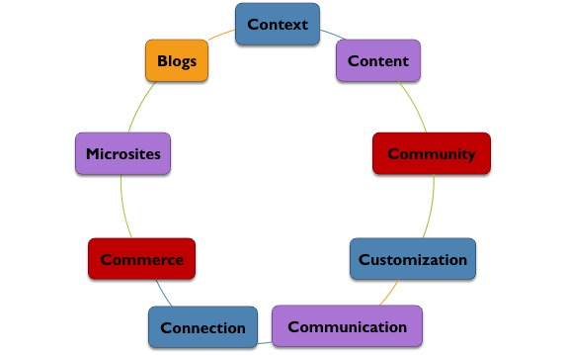
Dimensions of Website Interface
Notes:
Context refers to the overall layout, design, and aesthetic appeal of the site. Broadband and high-speed Internet has led to more graphics, video, and interesting design features that make the website more appealing. The perennial challenge for the web designer is balancing the aesthetic appeal of high graphic content with the download time for graphics and other complex visual elements. The look and feel of the site must be consistent with the organization or product’s overall brand image.
Content In the past organizations put their existing print materials (catalogs, for example) on the website and there was little in the way of original web content. Today, organizations’ websites incorporate a great deal of web-specific content. Organizations such as Costco and Target have a specific web strategy that displays products not available in stores, and many organizations such as The Gap offer web exclusive deals on products. Text, photos, videos, charts, and graphics are all part of web content.
A key advantage of web-based is the opportunity to create a community of users or visitors to the site. Blogs and company bulletin boards encourage a sense of community that enhances the customer’s company and product experience.
The ability to create a unique individual experience with a company website adds great value to the customer interface. Customers appreciate and expect customization of their website experience. Simple customization includes the ability to turn off the sound to the site and reduce the graphic interface (html versus flash sites). More customized sites enable customers to choose content and context.
Websites allow organizations to communicate with customers in three ways. First, companies communicate to customers and visitors to the website one-on-one through the Contact feature or e-mail. Second, customers and interested visitors communicate directly with the company through customer service requests. Finally, companies use instant messaging for customer service requests and sales inquiries.
Information sites such as Edmunds.com (automobiles) and cnet.com (electronics) offer a lot of information at the site but also allow users to access company and retailer websites when they need more information or wish to make a purchase. This kind of connectivity greatly expands the usefulness of the site for the user.
The number of products purchased online has grown dramatically, both in B2C and B2B markets. Web designers know that creating a simple, easy to understand, and secure purchase experience is essential for success in online commerce. Customers are still concerned with online purchase security; however, the convenience, pricing, and selection of the online purchase experience have led to significant growth in consumer online purchasing.
In addition to the company’s primary site many companies create smaller, more focused sites that deal with specific topics such as new product introductions or targeted products within a large product portfolio known as microsites. Ex. Auto co. Create sites for certain brands.
Blogs As noted previously, content is one of the seven key dimensions of web interface. One of the ways that an organization can communicate with potential customers and continue to communicate with current customers is through the development of a blog (a word that truncates the words “web” and “log”). An organization’s blog serves as a repository of content they create to provide information of interest to customers in the form of blog posts, which can be one or more paragraphs in length and written to stand on its own or be thematically connected to other posts.

Slide 25
Search Engine Optimization
SEO implies the different actions companies take to maximize the placement of their digital assets in relevant search engine results.
Being displayed near the top of searches increases the chance of being found by potential customers and strengthening ties with existing ones.
Notes:
The old adage that you want to be on the first page of a list of search results is absolutely true! Most, if not all, of the digital communication options we’ve discussed so far have implications for an organization’s SEO efforts. This is because, in a fairly simplified sense, search engines attempt to provide users with web results viewed to be the best fit for their specific searches based both on the relevance and the reputation of the source that pours into the output results. A benefit of having a website displayed towards the top of the results is that customers tend to view it as a more credible source, resulting in additional benefits to an organization and its brand beyond just a greater likelihood that the customer will click on the link.

Slide 26
Mobile Marketing
Mobile marketing, or the marketing of value offerings through a mobile communications device, is a central aspect of digital marketing strategies.
Primarily useful with smartphones and tablets.
Ads designed for small screens have challenges.
Most companies create separate websites that are mobile-friendly.
M-commerce is key to the customer experience so marketers need to work with IT to make meet expectations.
Notes:
A smartphone’s relatively smaller screen size and touch-based interface means that certain aspects of websites or ads designed may be viewed and interacted with differently than they would be on other media. Obviously, a navigational element on a website that would require a user to hover over a mouse to view its contents would not be suitable on a smartphone. So organizations tend to either construct separate mobile-friendly website, or alternatively include within their main websites responsive design elements that contain the ability to make adjustments (reorientation and resizing of sections of the site, touch friendly interfaces, and the like) based on the type of device that is being used to view it. For marketing managers, clearly these same considerations are important when developing ads that will be offered exclusively on mobile devices or across both mobile and non-mobile media types.
it is critical that marketing managers have a lead seat at the table with I.T. and operations to ensure that their organization’s websites are designed to make the shopping experience on different customer interface modalities as seamless as possible. Think of it this way: Customers who become frustrated with the process of making a purchase on their mobile device may drop out of the purchase process and instead seek out a competitor’s more user-friendly site instead, or they may slog through the painful purchase but vow never to come back.

Slide 27
Location-Based Targeting
Geo-location marketing is the use of geographic data to drive marketing messaging and other marketing management decisions.
Provides promotions when users are nearby a storefront or get them to return.
Can offer in-store promotions while shopping.
Knowing the customer’s location can improve satisfaction by providing real-time service (e.g., getting food ready for the right time the buyer arrives).

Slide 28
Text Messaging
SMS or short message service.
Used for instantly redeemable promotional offers, contest voting, sweepstakes participation, informational alerts, and many other real-time offers.
Simple to develop and use.
Make sure to have an opt-out or opt-in function.
Don’t become intrusive.

Slide 29
Branded Mobile Apps and In-App Based Ads
Branded mobile apps display the brand’s name and logo.
Mobile game apps, social media apps, and non-branded productivity apps offer opportunities for communication.
In-app ads or ads displayed within an app are another tool for marketers.
Notes:
Branded mobile apps display the brand’s name and logo in a prominent throughout the various screens and features within the app. These apps, which are a type of owned media, can be an effective means of communicating with customers because they offer numerous valuable functions and benefits that cause the customer to willingly decide to make the effort to do the download (many are free of course). An app can positively influence how the customer views the brand and stimulate purchase and loyalty.

Slide 30
Managing Social Media Marketing: Customer Involvement
Half of U.S. adults use two or more SM sites.
Marketers don’t control the conversation, users do.
Good use of SM can enhance the customer relationship but poorly executed SM can damage the firm’s reputation.
SM fits with paid, earned, and owned media.
Notes:
The ability for people to come together online has moved the conversation about an organization and its offerings away from the organization as initiator and into the hands of the public. Customers speak directly to each other about the good and bad of their product and service experiences. Organizations can monitor, participate, and respond but they cannot control this external dialogue, thus creating both opportunities and threats for organizations as they look to first understand the impact of social media on their business and then to develop effective marketing strategies to manage it.
The ability for people to come together online has moved the conversation about an organization and its offerings away from the organization as initiator and into the hands of the public. Customers speak directly to each other about the good and bad of their product and service experiences. Organizations can monitor, participate, and respond but they cannot control this external dialogue, thus creating both opportunities and threats for organizations as they look to first understand the impact of social media on their business and then to develop effective marketing strategies to manage it.

Slide 31
Types of Social Media
Social networks and viral marketing.
Product/service review sites.
Online brand communities.

Slide 32
Social Networks
Connects people through friendships, mutual interests, or another characteristic.
Hundreds available:
Facebook
Twitter
Snapchat
LinkedIn

Slide 33
Social Networks: Facebook and Twitter
Facebook | Twitter
1.5 billion active users | 300 million users
Broad base of users | 140 characters
Good for all size firms | Users expect quick response
While free, maintaining interesting content can require heavy investment

Slide 34
Social Networks: Snapchat and LinkedIn
Snapchat | LinkedIn
200 million users | 400 million users
Share photos and videos | Professionals
Time limits | Used for recruiting
60% of users age 13-24 | Good for B2B
Unique filters

Slide 35
Viral Marketing
Buzz marketing uses word-of-mouth.
Consider how social networks should be used.
A seeding strategy is deciding which group of customers to initiate the buzz.
Choose users who can spread the message deep within a group and across several groups.

Slide 36
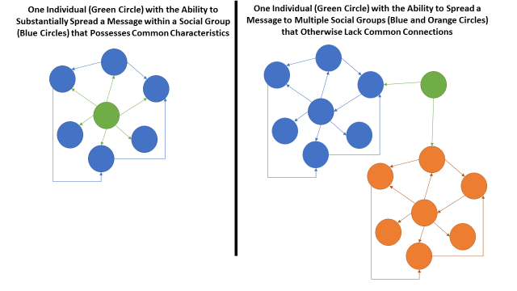
Seeding Strategy
Link to long alt text description
Notes:
Viral marketing has practical advantages for marketing managers. First, the “birds of a feather” aspect of viral marketing works to advantage since the group targeted by a seeding strategy most often possesses common bonds and thus content shared with by a social network member with other members may be viewed as more relevant, credible, and trustworthy versus the same content directly received from the marketer. Second, marketing budget efficiencies can be obtained when viral marketing is done successfully. Think of viral marketing as one of the most potent types of earned media in that it enables the spread of a marketing communication to potentially large audiences through the activation of individual users as marketing communication channels. In some cases, audience size reached through a viral marketing effort could be equivalent to what might have been obtained through the purchase of a television advertising spot requiring a substantial chunk of marketing budget.

Slide 37
Product and Service Review Sites
CNET | Urbanspoon | Consumersearch
Consumer technology | Restaurant reviews | Wide range of products
Electronics | User-generated | Reviews from other resources, like Amazon
Notes:
Product and service review sites offer the opportunity for customers to provide feedback on their experience with the organization and its offering, and also provide an information repository for customers to search for information before purchase. Because of these customer uses, marketers must continually monitor review sites that are relevant for their offerings.
Consider the results of a recent study finding that about 70 percent of Americans consult either a user review site or independent review site (with equal likelihood) before making a purchase.

Slide 38
Online Brand Communities
Allow customers to engage with the firm on its website.
Must be seen as honest.
Provide useful feedback.
Forums:
Provide product support.
Deal with product and service concerns.
build a sense of community among users.

Slide 39
Assessing the Value of Social Media Marketing
Customer behavior may not clearly or directly link to product purchase.
Big data analytics make it easier to assess value.
Notes:
Assessing the value of social media marketing efforts can be a real challenge for marketing managers, especially in terms that other organizational stakeholders are willing to accept as important to performance. This is especially the case when social media efforts do not drive easily tractable types of customer behaviors that are clearly and directly linked to specific product purchase (thus de facto linked to broader revenue and financial performance of the organization). For example, it is not at all
uncommon for C-suite executives to question the value of the number of “likes” or “followers” that are being generated by a given social media marketing campaign. As discussed in Chapter 5, nowadays greater analytic capabilities are making it easier for marketers to demonstrate the value derived from various digital marketing efforts, including social media marketing. Marketing managers need to redouble efforts to firm up the linkages between investments in marketing via social media platforms and important ROI based organizational outcomes.

Slide 40
Alt Text Appendix
All long alt text descriptions are included in this appendix.

Slide 41
Push and Pull Promotional Strategies
In a push strategy, the provider pushes the offering through personal selling, and sales promotion. Then, channel members do their own advertising and selling to end users. In a pull strategy, the provider creates demand by end users through promoting directly to them. Then, demand trickles up through the channel members, pulling product from the provider.

Slide 42
AIDA Model
The AIDA model has four steps. The first is attention, which is the cognitive step. The next is interest, which is the affective step. The third is desire, which is affective step. The final step is action, which is the behavioral step.

Slide 43
Retargeting
Retargeted ads work in four steps. Step 1: User visits your website and views a specific product page. Step 2: User leaves your website. Step 3: Sometime in the future while the user visits another website they see an ad for the product that he/she viewed on your website. Step 4: User responds to the ad and returns to your website and, ideally, purchases the related product.

Slide 44
Seeding Strategy
In the panel on the left, one green circle interacts with a group of blue circles that surround it. This represents one individual with the ability to substantially spread a lesson within a social group that possesses common characteristics. In the panel on the right, one green circle is between a cluster of blue circles and a cluster of orange ones, with arrows pointing to both groups. This represents how an individual (the green circle) with the ability to spread a message to multiple social groups that otherwise lack connections.

